Slide 1
Technical Writing
Revision: Unit 1 (Part 2)

Slide 2


Slide 3


Slide 4
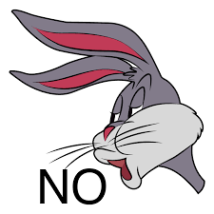


Theme

Slide 5


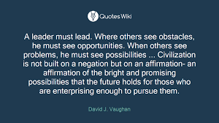
Becoming a Leader

Slide 6
Once More to the Text
Unit 1 (Rutherford) Learning Objectives:
To present the foundations of technical writing
To acquaint with audience, language and style and organization in technical writing
To acknowledge the presence of audience, language and style and organization in technical writing

Slide 7
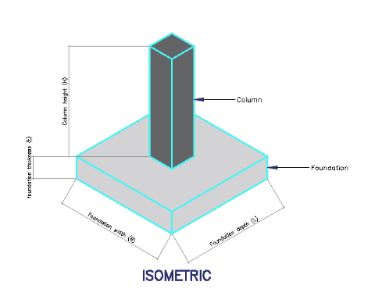
First up, the Basics
Technical writing= jotting down or drafting technical communication
Foundation= base/basis, cornerstone, backbone, concrete structure or underlying principle
Foundations of Technical writing: audience, purpose, language and style, organization

Slide 8
Factors to Consider in Technical Communication
TC is an act of transmitting facts and information to a defined audience for a specific purpose.
Audience: Who are the intended readers or viewers of the purported information? (Managers? Clients? Coworkers? General public? Unknown Audience? (Nontechnical)
While Analyzing Audience Focus on: What information does the audience presuppose?
What does he want to know?
What is he planning to do with the shared information?

Slide 9


Don’t Assume That…..
The audience knows my language (English)
S/he will read full writing
S/he will remember all the things you tell them
When s/he does not understand, the query will be issued.

Slide 10

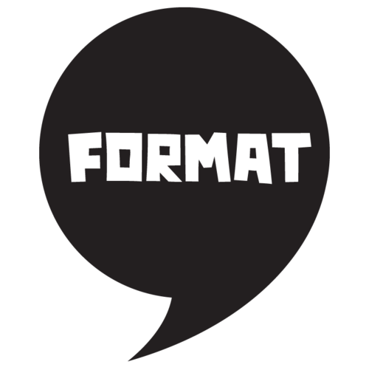
Factors…Cont.….
B) Purpose: What do you intend to do with the write-up (inform, educate, explain, describe, convince)
C) Format: In which format are you processing information? (Reports? Documents? Instructive manuals (Guides)? Correspondence (letters, memos, emails)? Presentations (Interviews, seminars)?

Slide 11
Lastly……
D) Style: What kind of language do you contemplate to apply? What about Organization and Layout? (Decided with the view of the first three factors: the background of the audience, need and purpose and format)
Language: Use of the technical terms or jargons; general terms and the definitions of the technical phrases and terms
Use of clear voice form (preferably active voice; straightforward)
Use of proper sentence length (shorter sentences; varying lengths)
Lessen/mitigate the use of negatives (especially double negatives confuse the readers)
Make suitable use of prefixes, suffixes and articles

Slide 12

Cont.…
Maintain decent attitude or tone
Use neutral Tone; not too formal or too informal or casual; prefer polite words to sarcastic, indirect, loaded (full of emotions) or sore ones
Don’t change the tone too swiftly

Slide 13
Organization
One of the most important of communication skills in technical writing
Consists of layout strategies (providing white space, etc.)
Related with the presentation of the matters
Management of the paragraphs into the meaningful patterns
For making the flow of information effective
Use of visual aids; classification of paragraphs (clear topic sentence, argument and thesis statement); outlines; lists and so on

Slide 14
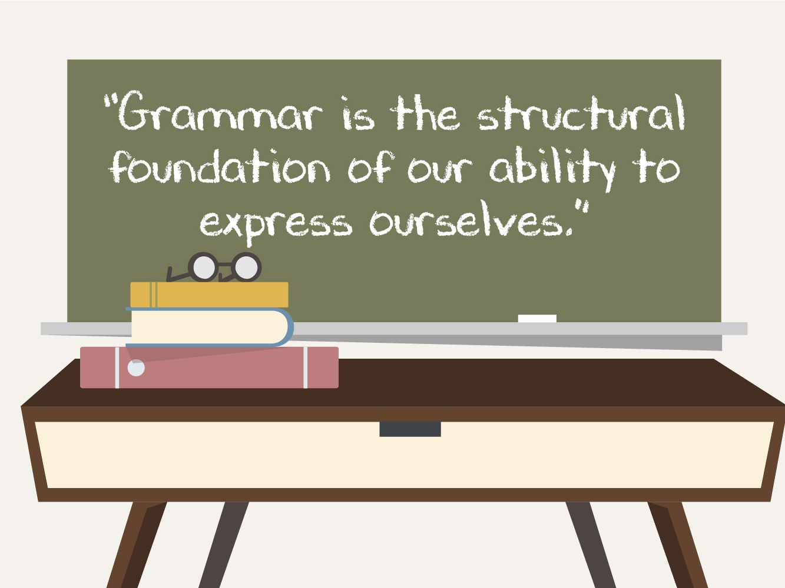
Watch out for Grammatical Units
Subjects and verbs agreement
Pronouns; pronoun references
Avoiding shifts
Modifiers
Clause and simple sentence
Compound sentences; complex sentences
Fragments, run-ones, and comma splices;
Transition words
Parallelism

